Slide 1
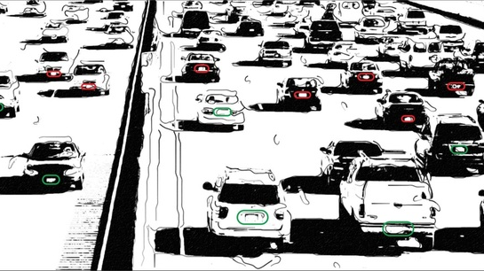
Number plate recognition system(NPR)
By ramzy labidi

Slide 2
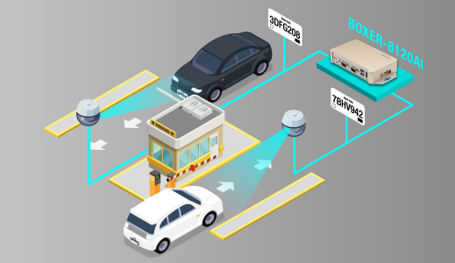
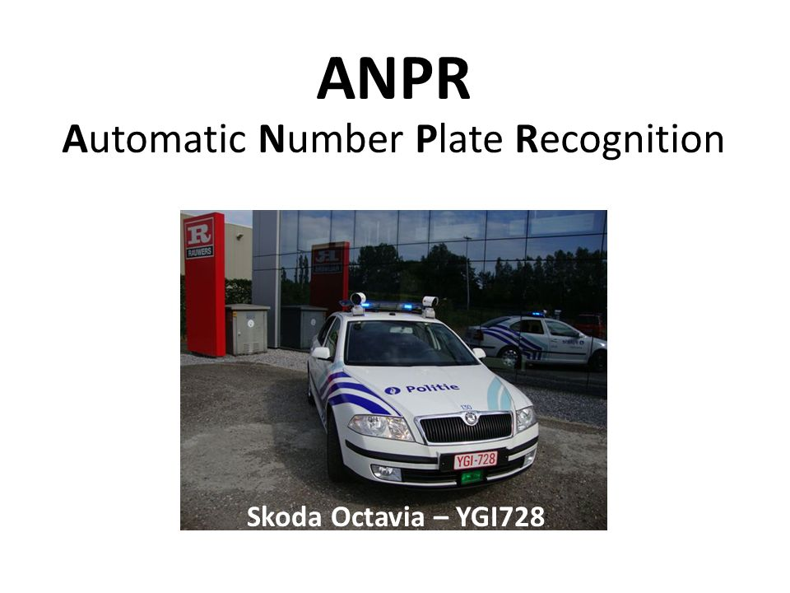
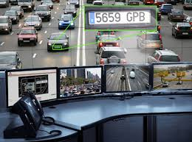
Introduction
Number plate recognition nowadays plays a vital role in our daily lifes from our security and safety on the streets and law enforcing to the convenient parking of our vehicles and city scale traffic management.

Slide 3
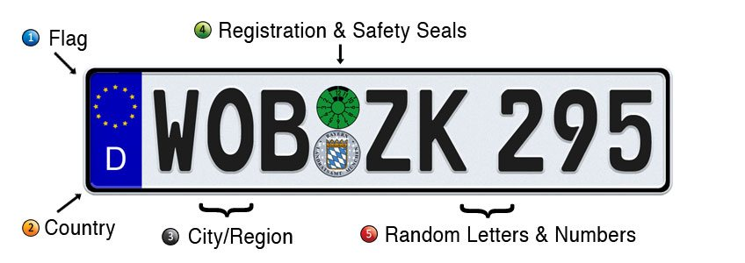

Slide 4
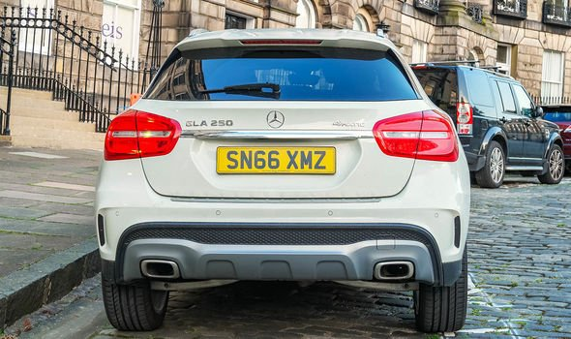








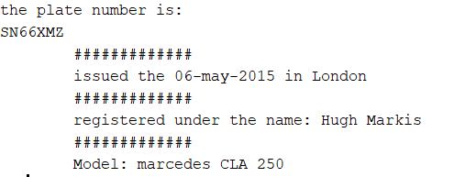
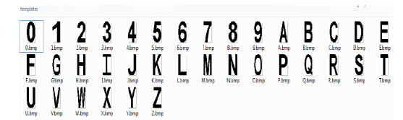
PROCESS:
The automatic number plate recognition system consists of 4 stages :
Image processing and Extraction of the number plate
Image acquisition
Outputting the result
Template matching

Slide 5
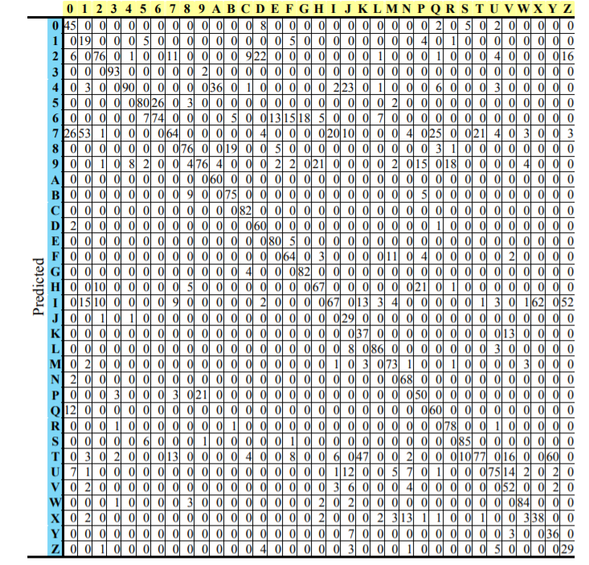
The image processing and number plate extraction is the most important part of the process.
So after applying the gray filter and then dilating ,and eroding the image we have to extract the letters one by one and compare them with the templates, in our example we have the number plate ‘SN66XMZ’ . For each character the algorithm is going to try matching it with all the templates and then choose the letter with the highest correlation value like so:
Beginning with S

Slide 6
.........
But of course as we can see there’s a correlation value of 1 for 8 and F and value of 6 for 4, in this case the values are very low so they won’t cause problems but if the value of correlation to ‘S’ was highest at ‘4’ then the system will think that the plate number is ‘4N66XMZ’.
Here the highest correlation value to ‘S’ is ‘S’

Slide 7



CHALLENGES ENCOUNTERED:
.Characters with very similar features
.Environmental conditions that I found impossible to solve on my own (lighting, reflection, shadows, etc)
.Moving cars
.Different fonts, textures on number plates →

Slide 8



CONCLUSION:
This was the first project I worked alone on, I had to plan my steps and work accordingly to make the deadlines. The work load was more than I anticipated, but through trial and error, I managed to create a functioning NPR.

Slide 9

hank you for your attention

